Slide 1

CUSTOMER INTERFACE DESIGN AND DEVELOPMENT
COURSE INCHARGE: E.BRUMANCIA
Dr.R.M.GOMATHI
COURSE CODE: SITA1502

Slide 2
COURSE OUTCOMES
On completion of the course, student will be able to
CO1 - Able to work with XML technologies.
CO2 - Design web page to perform form validation using client-side scripting language.
CO3 - Implement new technologies such as Angular JS & jQuery.
CO4 - Develop web applications using server-side scripting language.
CO5 - Understand the differences between usability and user experience.
CO6 - Effectively select and utilize design thinking processes and UX/UI tools.

Slide 3
UNIT 2 CLIENT SIDE SCRIPTING
Java Script
Advantages
Data types
Variables
Operators
Control statements
Functions
Objects and arrays
Windows and frames – Forms.
AJAX
XMLHttp Request (XHR)
Create Object
Request
Response
Ready state.

Slide 4
What is Java Script?
JavaScript is a dynamic computer programming language.
It is lightweight and most commonly used as a part of web pages, whose implementations allow client-side script to interact with the user and make dynamic pages.
It is an interpreted programming language with object-oriented capabilities.
History
JavaScript was first known as LiveScript.
Netscape changed its name to JavaScript.
JavaScript made its first appearance in Netscape 2.0 in 1995 with the name LiveScript.

Slide 5
JavaScript is a lightweight, interpreted programming language.
Designed for creating network-centric applications.
Complementary to and integrated with Java.
Complementary to and integrated with HTML.
Open and cross-platform.

Slide 6
Client-Side JavaScript
Client-side JavaScript is the most common form of the language.
The script should be included in or referenced by an HTML document for the code to be interpreted by the browser.
It means that a web page need not be a static HTML, but can include programs that interact with the user, control the browser, and dynamically create HTML content.
The JavaScript client-side mechanism provides many advantages over traditional CGI server-side scripts.
Example :
Registration form validation

Slide 7
Advantages of JavaScript
Less server interaction
Immediate feedback to the visitors
Increased interactivity
Richer interfaces

Slide 8
Limitations of JavaScript
Cannot treat JavaScript as a full-fledged programming language.
Client-side JavaScript does not allow the reading or writing of files. This has been kept for security reason.
JavaScript cannot be used for networking applications because there is no such support available.
JavaScript doesn't have any multithreading or multiprocessor capabilities.

Slide 9
JavaScript Development Tools
Microsoft FrontPage:
It provides web developers with a number of JavaScript tools to assist in the creation of interactive websites.
Macromedia Dreamweaver MX:
Macromedia Dreamweaver MX is a very popular HTML and JavaScript editor in the professional web development crowd.
It provides several handy prebuilt JavaScript components, integrates well with databases, and conforms to new standards such as XHTML and XML.
Macromedia HomeSite 5:
HomeSite 5 is a well-liked HTML and JavaScript editor from Macromedia that can be used to manage personal websites effectively.

Slide 10
Using JavaScript in your HTML
<script language="javascript" type="text/javascript">
JavaScript code
</script>
The script tag takes two important attributes:
Language: This attribute specifies what scripting language you are using. Typically, its value will be javascript. Although recent versions of HTML (and XHTML, its successor) have phased out the use of this attribute.
Type: This attribute is what is now recommended to indicate the scripting language in use and its value should be set to "text/javascript".

Slide 11
Your First JavaScriptCode
<html>
<head>
<title>Hello World in JavaScript</title>
</head>
<body>
<script language=“javaScript” type="text/javascript">
document.write("Hello World!");
</script>
</body>
</html

Slide 12
Whitespace and Line Breaks.
Semicolons are Optional
Case Sensitivity
Comments in JavaScript

Slide 13
Where to Put your Scripts
You can have any number of scripts
Scripts can be placed in the HEAD or in the BODY – In the HEAD, scripts are run before the page is displayed – In the BODY, scripts are run as the page is displayed
In the HEAD is the right place to define functions and variables that are used by scripts within the BODY
JavaScript in <head>...</head> Section
JavaScript in <body>...</body> Section
JavaScript in <body> and <head> Sections

Slide 14
JavaScript in <head>...</head> Section
<html>
<head>
<script type="text/javascript">
<!--
function sayHello() {
alert("Hello World")
}
//-->
</script>
</head>
<body>
Click here for the result
<input type="button" onclick="sayHello()" value="Say Hello" />
</body>
</html>

Slide 15
JavaScript in <body>...</body> Section
<html>
<head>
</head>
<body>
<script type="text/javascript">
<!--
document.write("Hello World")
//-->
</script>
<p>This is web page body </p>
</body>
</html>

Slide 16
JavaScript in <body> and <head> Sections
<html>
<head>
<script type="text/javascript">
<!--
function sayHello() {
alert("Hello World")
}
//-->
</script>
</head>
<body>
<script type="text/javascript">
<!--
document.write("Hello World")
//-->
</script>
<input type="button" onclick="sayHello()" value="Say Hello" />
</body>
</html>

Slide 17
JavaScript in External File
<html>
<head>
<script type="text/javascript" src=“ex6.js" ></script>
</head>
<body>
.......
</body>
</html>
ex6.js
function sayHello() {
alert("Hello World")
}

Slide 18
JavaScript Datatypes
JavaScript allows you to work with three primitive data types:
Numbers, e.g., 123, 120.50 etc.
Strings of text, e.g. "This text string" etc.
Boolean, e.g. true or false.
JavaScript also defines two trivial data types
null and undefined, each of which defines only a single value.
In addition to these primitive data types
JavaScript supports a composite data type known as object.

Slide 19
JavaScript Variables
Variables are declared with the var keyword.
<script type="text/javascript">
<!--
var money;
var name;
//-->
</script>

Slide 20
JavaScript Variable Scope
Global Variables: A global variable has global scope which means it can be defined anywhere in your JavaScript code.
Local Variables: A local variable will be visible only within a function where it is defined. Function parameters are always local to that function.
<script type="text/javascript">
<!--
var myVar = "global"; // Declare a global variable
function checkscope( ) {
var myVar = "local"; // Declare a local variable
document.write(myVar);
}
//-->
</script>

Slide 21
JavaScript Variable Names
You should not use any of the JavaScript reserved keywords as a variable name. These keywords are mentioned in the next section. For example, break or boolean variable names are not valid.
JavaScript variable names should not start with a numeral (0-9). They
must begin with a letter or an underscore character. For example, 123test is an invalid variable name but _123test is a valid one.
JavaScript variable names are case-sensitive. For example, Name and name are two different variables

Slide 22
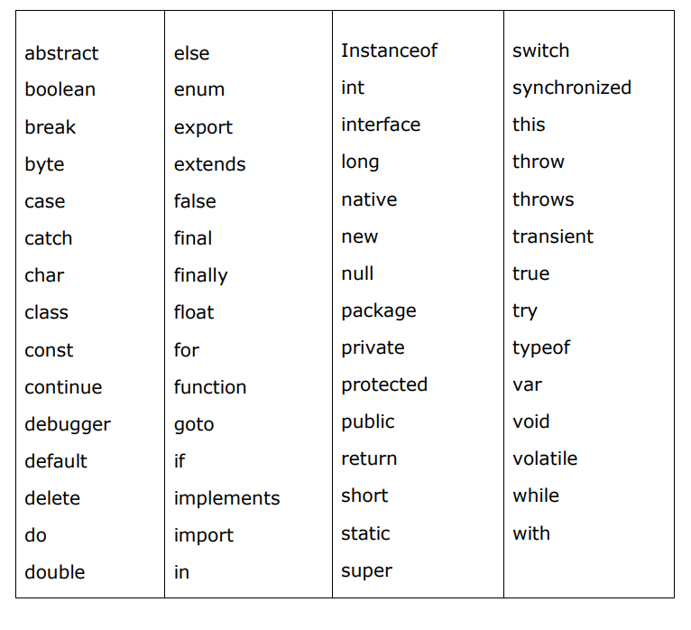
JavaScript Reserved Words

Slide 23
OPERATORS
What is an Operator?
Type of Operator
Arithmetic Operators
Comparison Operators
Logical (or Relational) Operators
Assignment Operators
Conditional (or ternary) Operators

Slide 24
Arithmetic Operators
+ (Addition)
-(Subtraction)
*(Multiplication)
/(Division)
%(Modulus)
++ (Increment)
-- (Decrement)

Slide 25
Comparison Operators
== (Equal)
!= (Not Equal)
> (Greater than)
< (Less than)
>= (Greater than or Equal to)
<= (Less than or Equal to)

Slide 26
Logical Operators
&& (Logical AND)
|| (Logical OR)
! (Logical NOT)

Slide 27
Bitwise Operators
& (Bitwise AND)
| (BitWise OR)
^ (Bitwise XOR)
~ (Bitwise Not)
<< (Left Shift)
>> (Right Shift)
>>> (Right shift with Zero)

Slide 28
Assignment Operators
= (Simple Assignment )
+= (Add and Assignment)
-= (Subtract and Assignment)
*= (Multiply and Assignment)
/= (Divide and Assignment)
%= (Modules and Assignment)

Slide 29
Miscellaneous Operators
Conditional Operator (? :)
Typeof Operator

Slide 30
Control Statements
JavaScript supports the following forms of if..else statement:
if statement
if...else statement
if...else if... Statement
<html>
<body>
<script type="text/javascript">
<!--
var age = 20;
if( age > 18 )
{
document.write("<b>Qualifies for driving</b>");
}
//-->
</script>
<p>Set the variable to different value and then try...</p>
</body>
</html>

Slide 31
If-else Statement
<html>
<body>
<script type="text/javascript">
<!--
var age = 15;
if( age > 18 ){
document.write("<b>Qualifies for driving</b>");
}else{
document.write("<b>Does not qualify for driving</b>");
}
//-->
</script>
<p>Set the variable to different value and then try...</p>
</body>
</html>

Slide 32
Else-if Statement
<html>
<body>
<script type="text/javascript">
<!--
var book = "maths";
if( book == "history" ){
document.write("<b>History Book</b>");
}else if( book == "maths" ){
document.write("<b>Maths Book</b>");
}else if( book == "economics" ){
document.write("<b>Economics Book</b>");
}else{
document.write("<b>Unknown Book</b>");
}
//-->
</script>
<p>Set the variable to different value and then try...</p>
</body>
</html>

Slide 33
SWITCH-CASE
<html>
<body>
<script type="text/javascript">
<!--
var grade='A';
document.write("Entering switch block<br />");
switch (grade)
{
case 'A': document.write("Good job<br />");
break;
case 'B': document.write("Pretty good<br />");
break;
case 'C': document.write("Passed<br />");
break;
case 'D': document.write("Not so good<br />");
break;
case 'F': document.write("Failed<br />");
break;
default: document.write("Unknown grade<br />")
}
document.write("Exiting switch block");
//-->
</script>
<p>Set the variable to different value and then try...</p>
</body>
</html>

Slide 34
whileLoop
<html>
<body>
<script type="text/javascript">
<!--
var count = 0;
document.write("Starting Loop ");
while (count < 10){
document.write("Current Count : " + count + "<br />");
count++;
}
document.write("Loop stopped!");
//-->
</script>
<p>Set the variable to different value and then try...</p>
</body>
</html>

Slide 35
Do-while loop
<html>
<body>
<script type="text/javascript">
<!--
var count = 0;
document.write("Starting Loop" + "<br />");
do{
document.write("Current Count : " + count + "<br />");
count++;
}while (count < 5);
document.write ("Loop stopped!");
//-->
</script>
<p>Set the variable to different value and then try...</p>
</body>
</html>

Slide 36
for loop
<html>
<body>
<script type="text/javascript">
<!--
var count;
document.write("Starting Loop" + "<br />");
for(count = 0; count < 10; count++){
document.write("Current Count : " + count );
document.write("<br />");
}
document.write("Loop stopped!");
//-->
</script>
<p>Set the variable to different value and then try...</p>
</body>
</html>

Slide 37
The break Statement
<html>
<body>
<script type="text/javascript">
<!--
var x = 1;
document.write("Entering the loop<br /> ");
while (x < 20)
{
if (x == 5){
break; // breaks out of loop completely
}
x = x + 1;
document.write( x + "<br />");
}
document.write("Exiting the loop!<br /> ");
//-->
</script>
<p>Set the variable to different value and then try...</p>
</body>
</html>

Slide 38
The Continue Statement
<html>
<body>
<script type="text/javascript">
<!--
var x = 1;
document.write("Entering the loop<br /> ");
while (x < 10)
{
x = x + 1;
if (x == 5){
continue;
}
document.write( x + "<br />");
}
document.write("Exiting the loop!<br /> ");
//-->
</script>
<p>Set the variable to different value and then try...</p>
</body>
</html>

Slide 39
Functions
A function is a group of reusable code which can be called anywhere in your program.
This eliminates the need of writing the same code again and again. It helps programmers in writing modular codes.
Functions allow a programmer to divide a big program into a number of small and manageable functions.
Syntax
<script type="text/javascript">
<!--
function functionname(parameter-list)
{
statements
}
//-->
</script>
A function in JavaScript is by using the function keyword, followed by a unique function name, a list of parameters (that might be empty), and a statement block surrounded by curly braces.

Slide 40
Calling a Function & Function Parameters
Refer ex3.html
<html>
<head>
<script type="text/javascript">
function display(name, age)
{
document.write (name + " is " + age + " years old.");
}
</script>
</head>
<body>
<p>Click the following button to call the function</p>
<form>
<input type="button" onclick=“display('Zara', 7)" value=“Display">
</form>
<p>Use different parameters inside the function and then try...</p>
</body>
</html>

Slide 41
Nested Function
<html>
<head>
<script type="text/javascript">
<!--
function hypotenuse(a, b) {
function square(x) { return x*x; }
return Math.sqrt(square(a) + square(b));
}
function secondFunction(){
var result;
result = hypotenuse(1,2);
document.write ( result );
}
//-->
</script>
</head>
<body>
<p>Click the following button to call the function</p>
<form>
<input type="button" onclick="secondFunction()" value="Call Function">
</form>
<p>Use different parameters inside the function and then try...</p>
</body>
</html>

Slide 42
Function () Constructor
<script type="text/javascript">
<!--
var variablename = new Function(Arg1, Arg2..., "Function Body");
//-->
</script>
The Function() constructor is not passed any argument that specifies a name for the function it creates.
The unnamed functions created with the Function() constructor are called anonymous functions.

Slide 43
<html>
<head>
<script type="text/javascript">
<!--
var func = new Function("x", "y", "return x*y;");
function secondFunction(){
var result;
result = func(10,20);
document.write ( result );
}
//-->
</script>
</head>
<body>
<p>Click the following button to call the function</p>
<form>
<input type="button" onclick="secondFunction()" value="Call Function">
</form>
<p>Use different parameters inside the function and then try...</p>
</body>
</html>

Slide 44
Form validation
<html>
<head>
<script type="text/javascript">
<!-->
function validateform()
{
var name=document.myform.name.value;
var password=document.myform.password.value;
if (name==null || name=="")
{
alert("Name can't be blank");
return false;
}
else if(password.length<6)
{
alert("Password must be at least 6 characters long.");
return false;
}
}
//-->
</script>
</head>
<body>
<form name="myform" method="post" action="ex3.html" onsubmit="return validateform()" >
Name: <input type="text" name="name"><br/>
Password: <input type="password" name="password"><br/>
<input type="submit" value="register">
</form>
</body>
</html>

Slide 45
OBJECTS
JavaScript is an Object Oriented Programming (OOP) language.
Encapsulation
Aggregation
Inheritance
Polymorphism

Slide 46
JavaScript Objects
A javaScript object is an entity having state and behavior (properties and method). For example: car, pen, bike, chair, glass, keyboard, monitor etc.
JavaScript is an object-based language. Everything is an object in JavaScript.
JavaScript is template based not class based. Here, we don't create class to get the object. But, we direct create objects.
The syntax of creating object directly is given below:
var objectname=new Object();
Here, new keyword is used to create object.

Slide 47
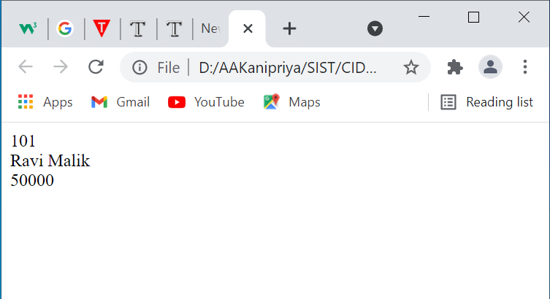
<html>
<body>
<script>
var emp=new Object();
emp.id=101;
emp.name="Ravi Malik";
emp.salary=50000;
document.write(emp.id+" "+emp.name+" "+emp.salary);
</script>
</body>
</html>
Output

Slide 48
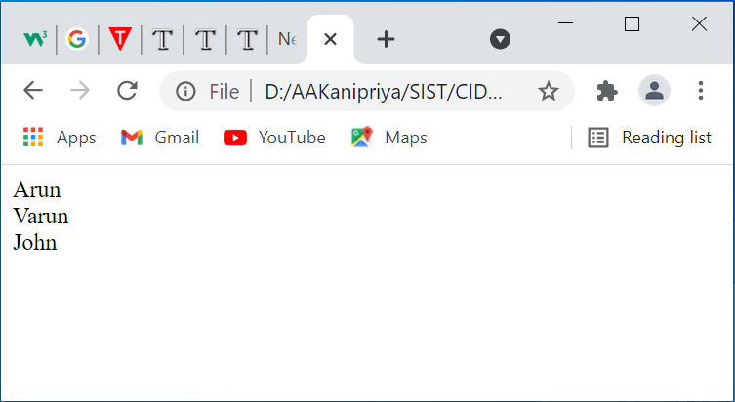
JavaScript Array
JavaScript array is an object that represents a collection of similar type of elements.
The syntax of creating array directly is given below:
var arrayname=new Array();
<html>
<body>
<script>
var i;
var emp = new Array();
emp[0] = "Arun";
emp[1] = "Varun";
emp[2] = "John";
for (i=0;i<emp.length;i++){
document.write(emp[i] + "<br>");
}
</script>
</body>
</html>
Output

Slide 49
Array Methods
concat()
Returns a new array comprised of this array joined with other array(s) and/or value(s).
indexOf()
Returns the first (least) index of an element within the array equal to the specified value, or -1 if none is found.
join()
Joins all elements of an array into a string.
pop()
Removes the last element from an array and returns that element.
push()
Adds one or more elements to the end of an array and returns the new length of the array.

Slide 50
reverse()
Reverses the order of the elements of an array -- the first becomes the last, and the last becomes the first.
slice()
Extracts a section of an array and returns a new array.
sort()
Sorts the elements of an array

Slide 51
Program Using concat()
<html>
<head>
<title>JavaScript Array concat Method</title>
</head>
<body>
<script type = "text/javascript">
var alpha = ["a", "b", "c"];
var numeric = [1, 2, 3];
var alphaNumeric = alpha.concat(numeric);
document.write("alphaNumeric : " + alphaNumeric );
</script>
</body>
</html>
Output
alphaNumeric : a,b,c,1,2,3

Slide 52
JavaScript - Array pop() Method
<html>
<head>
<title>JavaScript Array pop Method</title>
</head>
<body>
<script type = "text/javascript">
var numbers = [1, 4, 9];
var element = numbers.pop();
document.write("element is : " + element );
var element = numbers.pop();
document.write("<br />element is : " + element );
</script>
</body>
</html>
Output
element is : 9
element is : 4

Slide 53
JavaScript - Array sort() Method
<html>
<head>
<title>JavaScript Array sort Method</title>
</head>
<body>
<script type = "text/javascript">
var arr = new Array("orange", "mango", "banana", "sugar");
var sorted = arr.sort();
document.write("Returned string is : " + sorted );
</script>
</body>
</html>
Output
Returned array is : banana,mango,orange,sugar

Slide 54
Date Object
Date is a data type.
Date object manipulates date and time.
Date() constructor takes no arguments.
Date object allows you to get and set the year, month, day, hour, minute, second and millisecond fields.
Syntax: var variable_name = new Date();

Slide 55
Date Methods
Date(): Returns current date and time.
getDate(): Returns the day of the month.
getDay(): Returns the day of the week.
getFullYear(): Returns the year.
getHours(): Returns the hour.
getMinutes(): Returns the minutes.
getSeconds(): Returns the seconds.
getMilliseconds(): Returns the milliseconds.

Slide 56
<html> <body> <center> <h2>Date Methods</h2> <script type="text/javascript"> var d = new Date(); document.write("<b>Locale String:</b> " + d.toLocaleString()+"<br>"); document.write("<b>Hours:</b> " + d.getHours()+"<br>"); document.write("<b>Day:</b> " + d.getDay()+"<br>"); document.write("<b>Month:</b> " + d.getMonth()+"<br>"); document.write("<b>FullYear:</b> " + d.getFullYear()+"<br>"); document.write("<b>Minutes:</b> " + d.getMinutes()+"<br>"); </script> </center> </body> </html>

Slide 57
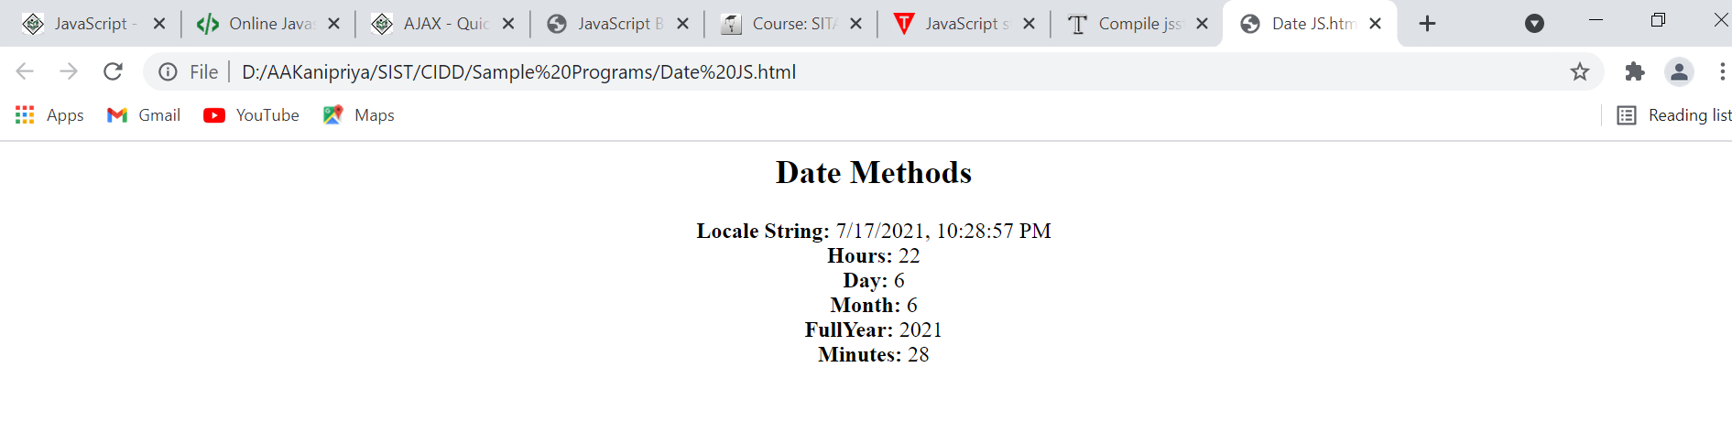
Output

Slide 58
JavaScript String
The JavaScript string is an object that represents a sequence of characters.
String Methods
Here is a list of the methods available in String object along with their description.
charAt()
Returns the character at the specified index.
concat()
Combines the text of two strings and returns a new string.
indexOf()
Returns the index within the calling String object of the first occurrence of the specified value, or -1 if not found.

Slide 59
slice()
Extracts a section of a string and returns a new string.
substr()
Returns the characters in a string beginning at the specified location through the specified number of characters.
toLowerCase()
Returns the calling string value converted to lower case.
toUpperCase()
Returns the calling string value converted to uppercase.

Slide 60
<!DOCTYPE html>
<html>
<body>
<script>
var s1="javascript ";
var s2="concat example";
var s3=s1.concat(s2);
document.write("String Concat:"+s3+"</br>");
var str="javascript";
document.write("CharAt:"+str.charAt(2)+"</br>");
document.write("Substring:"+str.substr(2,4)+"</br>");
var s1="javascript from sample programs";
var n=s1.indexOf("from");
document.write("Index Value is:"+n+"</br>");
var s1="JavaScript toLowerCase Example";
var s2=s1.toLowerCase();
document.write("Lowercase Letters:"+s2+"</br>");
var s1="abcdefgh";
var s2=s1.slice(2,5);
document.write("Sliced String:"+s2);
</script>
</body>
</html>

Slide 61
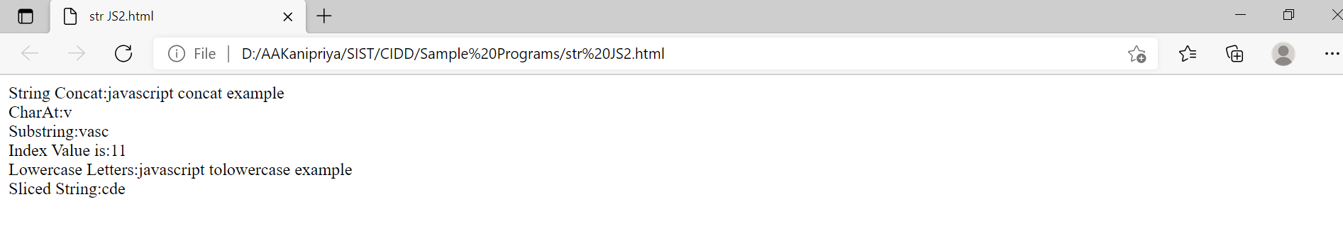
Output

Slide 62
JavaScript Math
The JavaScript math object provides several constants and methods to perform mathematical operation. Unlike date object, it doesn't have constructors.
abs()
Returns the absolute value of a number.
ceil()
Returns the smallest integer greater than or equal to a number.
floor()
Returns the largest integer less than or equal to a number.
max()
Returns the largest of zero or more numbers.

Slide 63
min()
Returns the smallest of zero or more numbers.
pow()
Returns base to the exponent power, that is, base exponent.
sqrt()
Returns the square root of a number.
tan()
Returns the tangent of a number.

Slide 64
<html>
<head>
<title>JavaScript Math functions </title>
</head>
<body>
<script type = "text/javascript">
var value = Math.max(10, 20, -1, 100);
document.write("Max Value : " + value );
var value = Math.min(10, 20, -1, 100);
document.write("<br />Min Value : " + value );
var value = Math.pow(7, 2);
document.write("<br />Square value : " + value );
var value = Math.sqrt( 81 );
document.write("<br />Square root Value : " + value );
var value = Math.tan( 45 );
document.write("<br />tan Value : " + value );
</script>
</body>
</html>

Slide 65
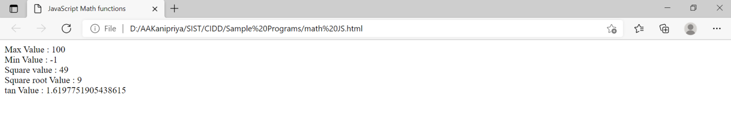
Output

Slide 66
JavaScript Number Object
The JavaScript number object enables you to represent a numeric value. It may be integer or floating-point.
JavaScript number object follows IEEE standard to represent the floating-point numbers.
By the help of Number() constructor, you can create number object in JavaScript. For example:
var n=new Number(value);

Slide 67
Number Methods
Sr.No. | Method & Description
1 | toExponential() Forces a number to display in exponential notation, even if the number is in the range in which JavaScript normally uses standard notation.
2 | toFixed() Formats a number with a specific number of digits to the right of the decimal.
3 | toLocaleString() Returns a string value version of the current number in a format that may vary according to a browser's local settings.
4 | toPrecision() Defines how many total digits (including digits to the left and right of the decimal) to display of a number.
5 | toString() Returns the string representation of the number's value.
6 | valueOf() Returns the number's value.

Slide 68
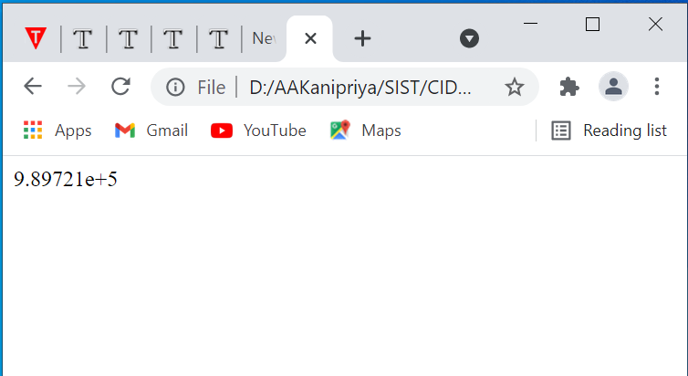
Output
<!DOCTYPE html>
<html>
<body>
<script>
var a=989721;
document.writeln(a.toExponential());
</script>
</body>
</html>

Slide 69
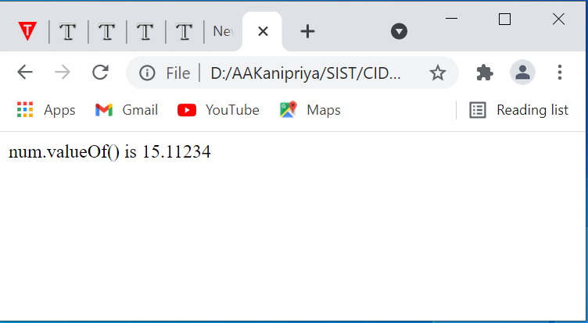
Output
<html>
<head>
<title>JavaScript valueOf() Method </title>
</head>
<body>
<script type = "text/javascript">
var num = new Number(15.11234);
document.write("num.valueOf() is " + num.valueOf());
</script>
</body>
</html>

Slide 70
The Window Object
The window object is supported by all browsers. It represents the browser's window.
All global JavaScript objects, functions, and variables automatically become members of the window object.
Global variables are properties of the window object.
Global functions are methods of the window object.
Even the document object (of the HTML DOM) is a property of the window object:
document.getElementById("header");

Slide 71
Window Size
Two properties can be used to determine the size of the browser window.
Both properties return the sizes in pixels:
window.innerHeight - the inner height of the browser window (in pixels)
window.innerWidth - the inner width of the browser window (in pixels)

Slide 72
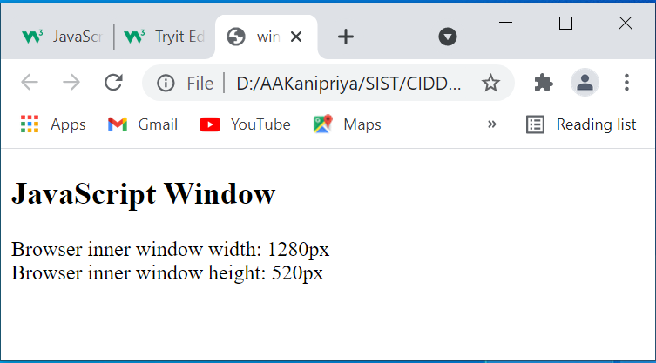
Output
<!DOCTYPE html>
<html>
<body>
<h2>JavaScript Window</h2>
<p id="demo"></p>
<script>
document.getElementById("demo").innerHTML =
"Browser inner window width: " + window.innerWidth + "px<br>" +
"Browser inner window height: " + window.innerHeight + "px";
</script>
</body>
</html>

Slide 73
Location Object
Location object is a part of the window object.
It is accessed through the 'window.location' property.
It contains the information about the current URL.
Property | Description
hash | It returns the anchor portion of a URL.
host | It returns the hostname and port of a URL.
hostname | It returns the hostname of a URL.
href | It returns the entire URL.
pathname | It returns the path name of a URL.
port | It returns the port number the server uses for a URL.
protocol | It returns the protocol of a URL.
search | It returns the query portion of a URL.

Slide 74
Location Object Methods
Method | Description
assign() | It loads a new document.
reload() | It reloads the current document.
replace() | It replaces the current document with a new one.

Slide 75
Simple Program on Location Object
<html> <body> <script type="text/javascript"> document.write("<b>Path Name: </b>"+location.pathname+"<br><br>"); document.write("<b>Href: </b>"+location.href+"<br><br>"); document.write("<b>Protocol: </b>"+location.protcol+"<br><br>"); </script> </body> </html>
Output
Path Name: /webprj/ZYHerDfFj/index.html Href: https://www.onlinegdb.com/webprj/ZYHerDfFj/index.html Protocol: undefined

Slide 76
Window Location Assign The window.location.assign() method loads a new document.
<!DOCTYPE html>
<html>
<body>
<h2>JavaScript</h2>
<h3>The window.location object</h3>
<input type="button" value="Load new document" onclick="newDoc()">
<script>
function newDoc() {
window.location.assign("https://www.w3schools.com")
}
</script>
</body>
</html>

Slide 77
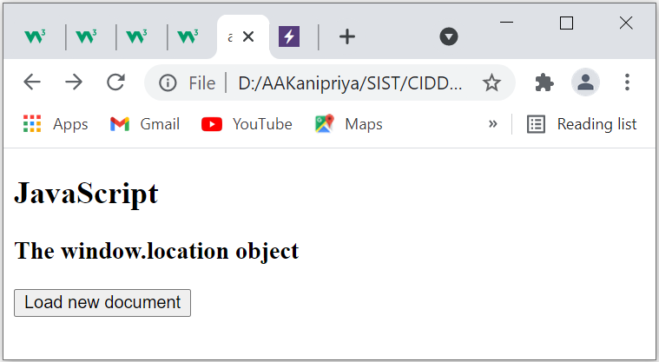
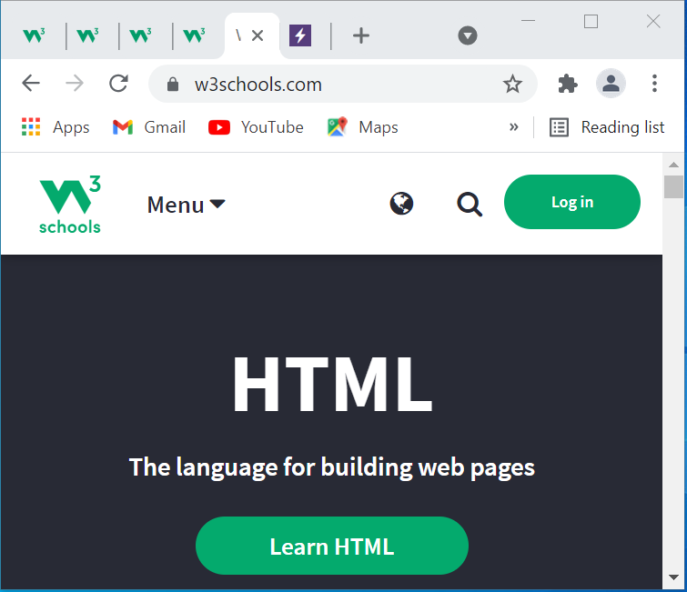
Output

Slide 78
JavaScript Popup Boxes
JavaScript has three kind of popup boxes: Alert box, Confirm box, and Prompt box.
Alert Box
An alert box is often used if you want to make sure information comes through to the user.
When an alert box pops up, the user will have to click "OK" to proceed.
Syntax: window.alert("sometext");

Slide 79
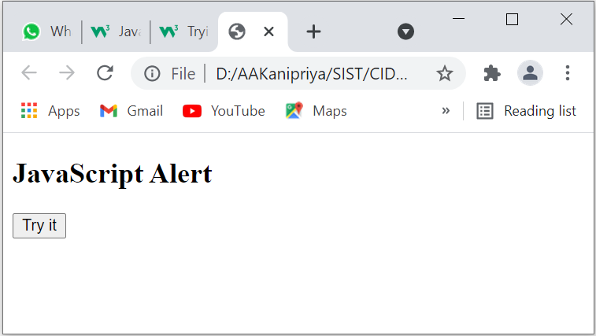
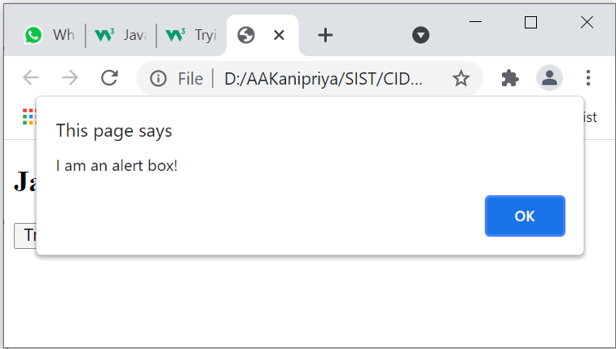
Sample program for alert box
<!DOCTYPE html>
<html>
<body>
<h2>JavaScript Alert</h2>
<button onclick="myFunction()">Try it</button>
<script>
function myFunction() {
window.alert("I am an alert box!");
}
</script>
</body>
</html>

Slide 80
Confirm Box
A confirm box is often used if you want the user to verify or accept something.
When a confirm box pops up, the user will have to click either "OK" or "Cancel" to proceed.
If the user clicks "OK", the box returns true. If the user clicks "Cancel", the box returns false.
Syntax: window.confirm("sometext");

Slide 81
Sample program for confirm box
if (window.confirm("Press a button!")) {
txt = "You pressed OK!";
} else {
txt = "You pressed Cancel!";
}
document.getElementById("demo").innerHTML = txt;
}
</script>
</body>
</html>
<!DOCTYPE html>
<html>
<body>
<h2>JavaScript Confirm Box</h2>
<button onclick="myFunction()">Try it</button>
<p id="demo"></p>
<script>
function myFunction() {
var txt;

Slide 82
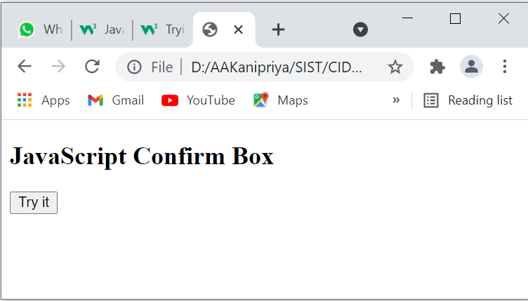
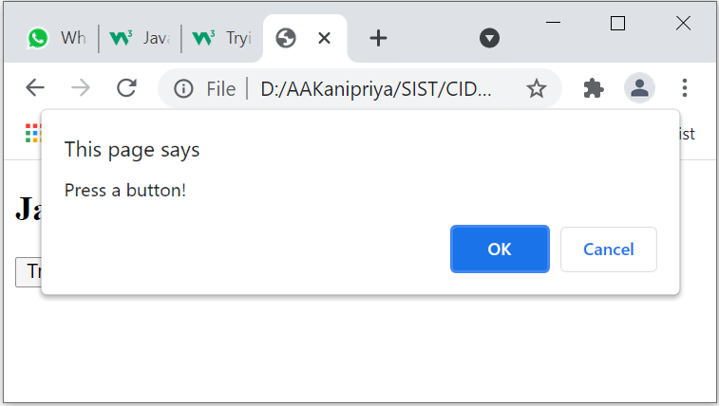
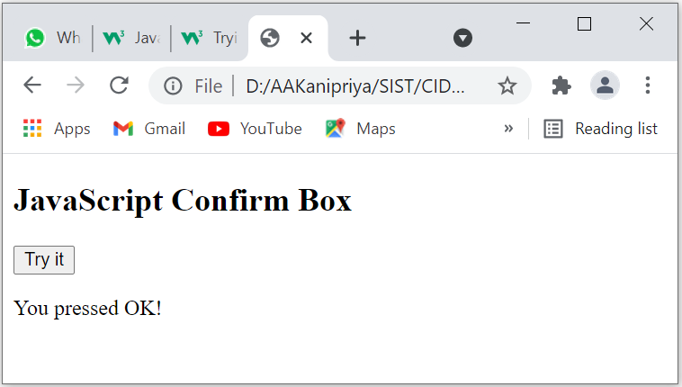
Initial Output window
Output window after clicking on Try it button
Output window after clicking on OK button

Slide 83
Prompt Box
A prompt box is often used if you want the user to input a value before entering a page.
When a prompt box pops up, the user will have to click either "OK" or "Cancel" to proceed after entering an input value.
If the user clicks "OK" the box returns the input value. If the user clicks "Cancel" the box returns null.
Syntax: window.prompt("sometext","defaultText");

Slide 84
var person = prompt("Please enter your name:");
if (person == null || person == "") {
text = "User cancelled the prompt.";
} else {
text = "Hello " + person + "! How are you today?";
}
document.getElementById("demo").innerHTML = text;
}
</script>
</body>
</html>
<!DOCTYPE html>
<html>
<body>
<h2>JavaScript Prompt</h2>
<button onclick="myFunction()">Try it</button>
<p id="demo"></p>
<script>
function myFunction() {
var text;

Slide 85
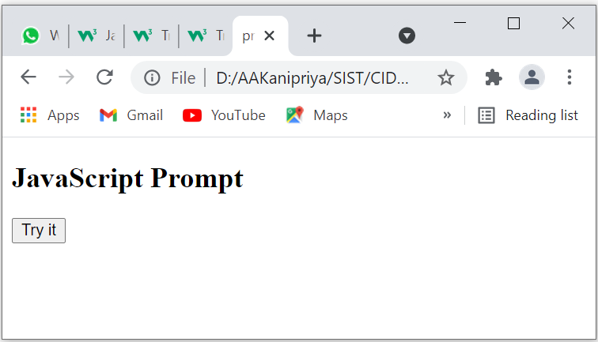
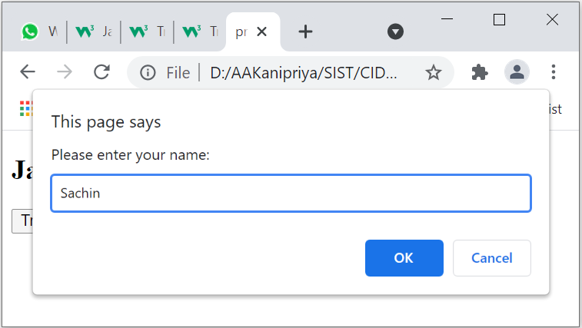
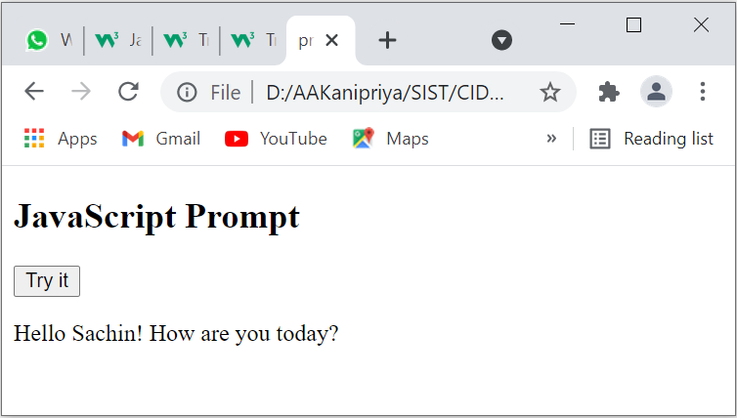
1) Initial Output
2) Output window after clicking Try it button
3) Output window after clicking OK button

Slide 86
Frames
Frames are used to divide your browser window into multiple sections where each section can load a separate HTML document.
A collection of frames in the browser window is known as a frameset.
The window is divided into frames in a similar way the tables are organized: into rows and columns.
The HTML <iframe> tag specifies an inline frame.
An inline frame is used to embed another document within the current HTML document.
Syntax
<iframe src="url" title="description"></iframe>

Slide 87
Sample Program for Frame Object
<!DOCTYPE html>
<html>
<body>
<p>Click the button to loop through the frames on this page, and change the location of every frame to "welcome page".</p>
<button onclick="myFunction()">Try it</button>
<br><br>
<iframe src="alert.html"></iframe>
<iframe src="confirm.html"></iframe>
<iframe src="prompt.html"></iframe>
<script>
function myFunction()
{
var frames = window.frames;
var i;
for (i = 0; i < frames.length; i++)
{
frames[i].location = "welcome.html";
}
}
</script>
</body>
</html>

Slide 88
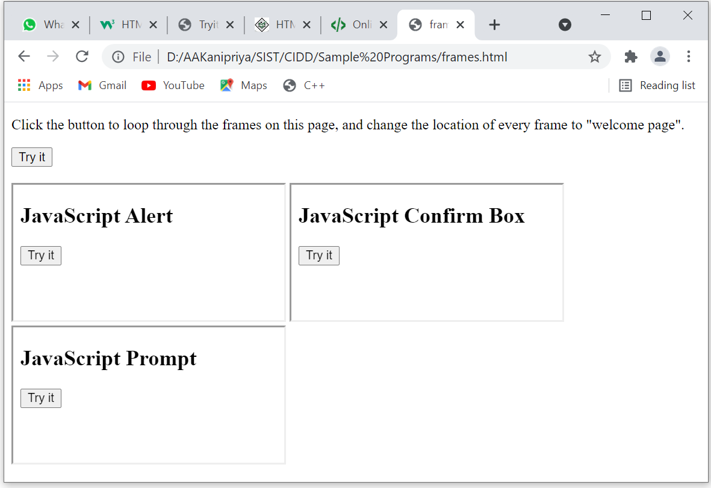
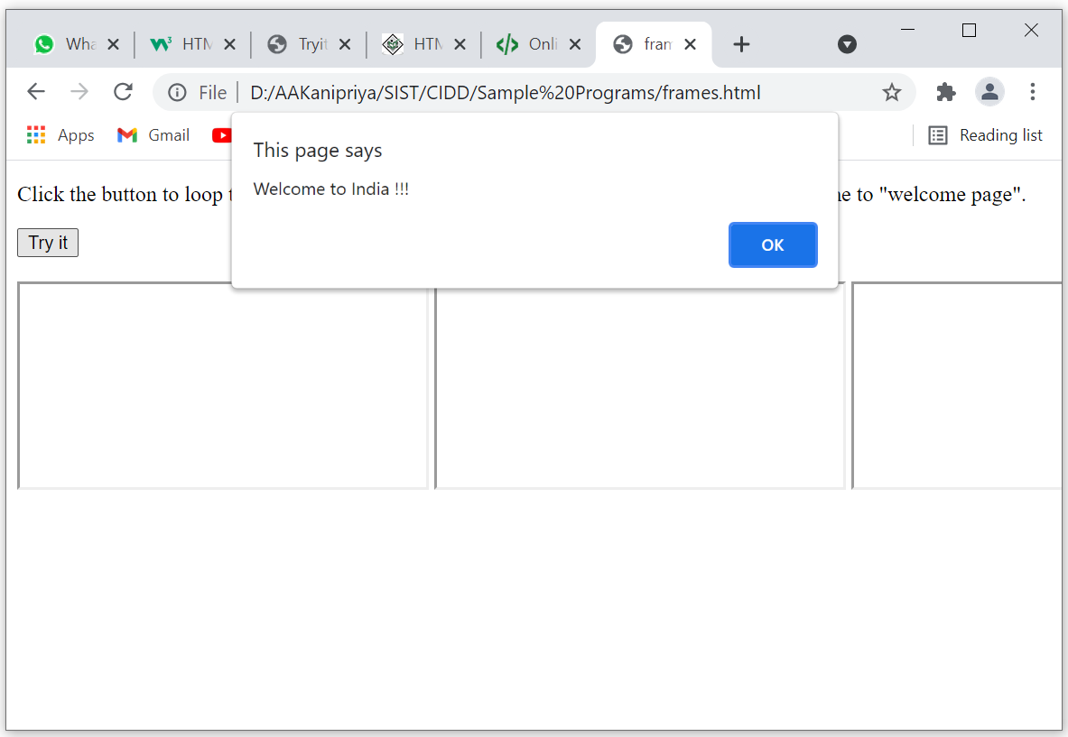
Output

Slide 89
Forms
An HTML form is used to collect user input. The user input is most often sent to a server for processing.
The HTML <form> element is used to create an HTML form for user input.
The <form> element is a container for different types of input elements, such as: text fields, checkboxes, radio buttons, submit buttons, etc.

Slide 90
Form Attributes
The Action Attribute
The action attribute defines the action to be performed when the form is submitted.
Usually, the form data is sent to a file on the server when the user clicks on the submit button.
The Target Attribute
The target attribute specifies where to display the response that is received after submitting the form.

Slide 91
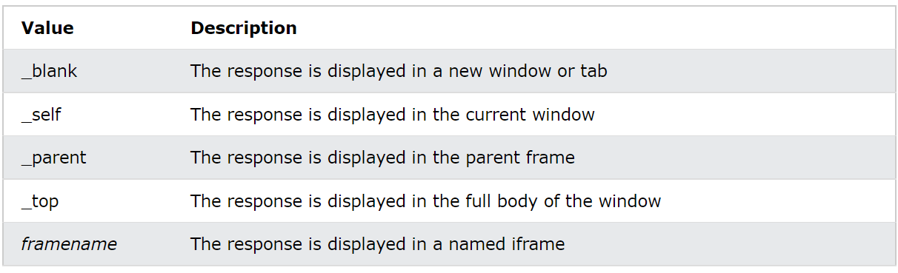
The target attribute can have one of the following values:

Slide 92
The Method Attribute
The method attribute specifies the HTTP method to be used when submitting the form data.
The form-data can be sent as URL variables (with method="get") or as HTTP post transaction (with method="post").
The default HTTP method when submitting form data is GET.
After clicking on the submit, the form values will be visible in the address bar of the new browser tab when the form uses get method.
Whereas the form values will not be visible in the address bar of the new browser tab when the form uses the post method.

Slide 93
Sample Program-1 using Form Object
<!DOCTYPE html>
<html>
<body>
<p>Enter names in the fields, then click "Submit" to submit the form:</p>
<form id="frm1" action="http://www.google.com">
First name: <input type="text" name="fname"><br>
Last name: <input type="text" name="lname"><br><br>
<input type="button" onclick="myFunction()" value="Submit">
</form>
<script>
function myFunction() {
document.getElementById("frm1").submit();
}
</script>
</body>
</html>

Slide 94
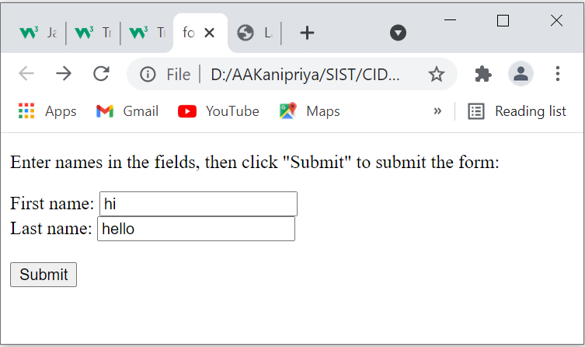
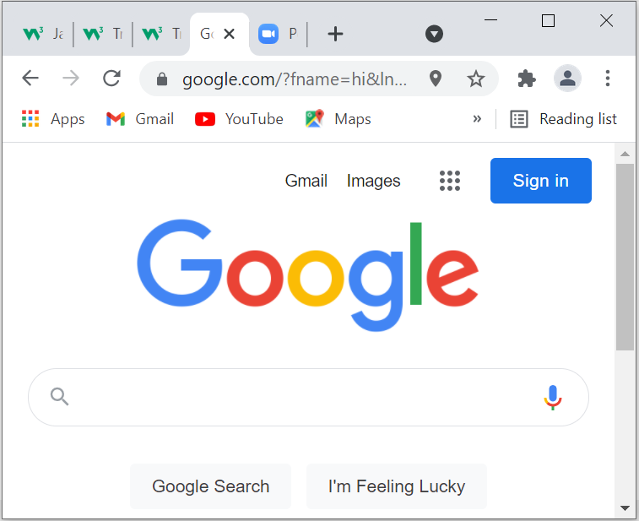
Output

Slide 95
Sample program-2
<!DOCTYPE html>
<html>
<body>
<h2>JavaScript Validation</h2>
<p>Please input a number between 1 and 10:</p>
<input id="numb">
<button type="button" onclick="myFunction()">Submit</button>
<p id="demo"></p>
<script>
function myFunction() {
// Get the value of the input field with id="numb"
let x = document.getElementById("numb").value;
// If x is Not a Number or less than one or greater than 10
let text;
if (isNaN(x) || x < 1 || x > 10) {
text = "Input not valid";
} else {
text = "Input OK";
}
document.getElementById("demo").innerHTML = text;
}
</script>
</body>
</html>

Slide 96
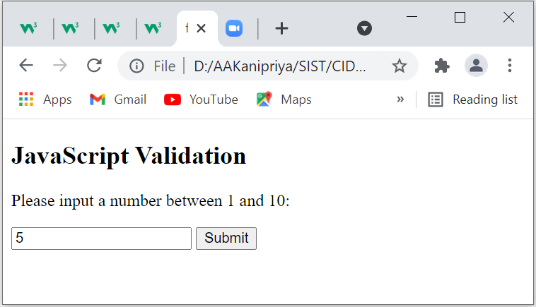
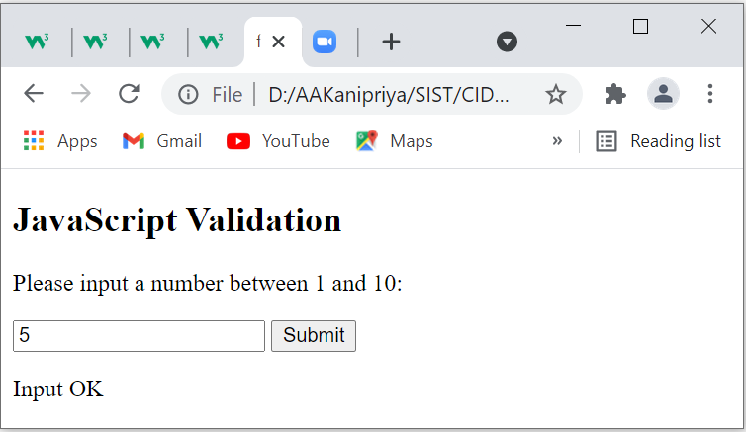
Output

Slide 97
AJAX
AJAX = Asynchronous JavaScript And XML.
AJAX is not a programming language.
AJAX just uses a combination of:
A browser built-in XMLHttpRequest object (to request data from a web server)
JavaScript and HTML DOM (to display or use the data)
AJAX allows web pages to be updated asynchronously by exchanging data with a web server behind the scenes. This means that it is possible to update parts of a web page, without reloading the whole page.

Slide 98
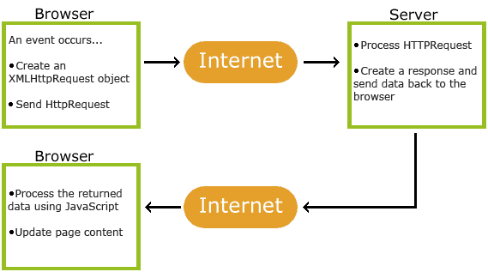
How AJAX Works

Slide 99
1. An event occurs in a web page (the page is loaded, a button is clicked)
2. An XMLHttpRequest object is created by JavaScript
3. The XMLHttpRequest object sends a request to a web server
4. The server processes the request
5. The server sends a response back to the web page
6. The response is read by JavaScript
7. Proper action (like page update) is performed by JavaScript

Slide 100
The XMLHttpRequest Object
All modern browsers support the XMLHttpRequest object.
The XMLHttpRequest object can be used to exchange data with a server behind the scenes.
This means that it is possible to update parts of a web page, without reloading the whole page.
Syntax for creating an XMLHttpRequest object:
var xhttp = new XMLHttpRequest();

Slide 101
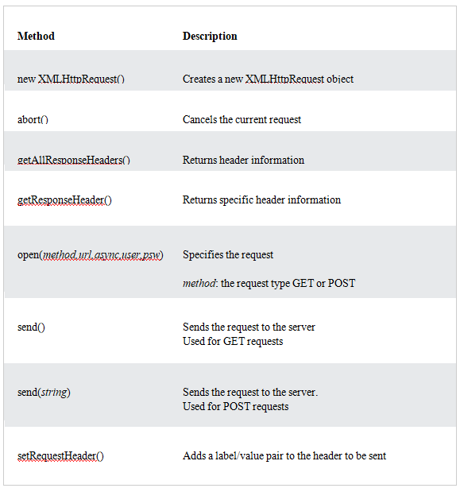
XMLHttpRequest Object Methods

Slide 102
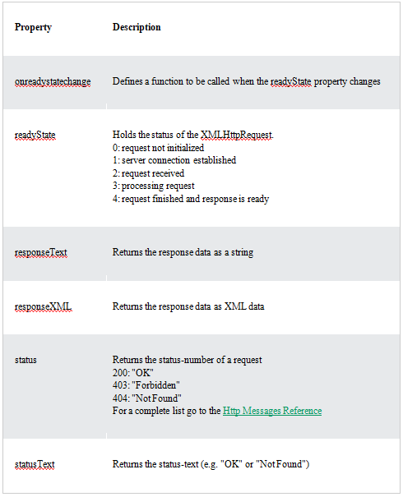
XMLHttpRequest Object Properties

Slide 103
AJAX Example
if (this.readyState == 4 && this.status == 200)
{
document.getElementById("demo").innerHTML =
this.responseText;
}
};
xhttp.open("GET", "ajax_info.txt", true);
xhttp.send();
}
</script>
</body>
</html>
<!DOCTYPE html>
<html>
<body>
<div id="demo">
<h1>The XMLHttpRequest Object</h1>
<button type="button" onclick="loadDoc()">Change Content</button>
</div>
<script>
function loadDoc() {
var xhttp = new XMLHttpRequest();
xhttp.onreadystatechange = function()
{

Slide 104
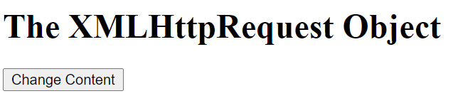
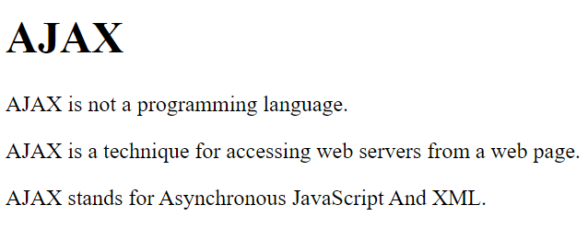
Output
The output will look like the following after the change content button has been clicked.

Slide 105
Server Response Properties
Property | Description
responseText | get the response data as a string
responseXML | get the response data as XML data
Server Response Methods
Method | Description
getResponseHeader() | Returns specific header information from the server resource
getAllResponseHeaders() | Returns all the header information from the server resource

Slide 106
The responseText Property
The responseText property returns the server response as a JavaScript string
The responseXML Property
The XMLHttpRequest object has an in-built XML parser.
The responseXML property returns the server response as an XML DOM object.
Using this property you can parse the response as an XML DOM object

Slide 107
<!DOCTYPE html>
<html>
<body>
<h2>The XMLHttpRequest Object</h2>
<p id="demo"></p>
<script>
const xhttp = new XMLHttpRequest();
xhttp.onload = function() {
const xmlDoc = this.responseXML;
const x = xmlDoc.getElementsByTagName("ARTIST");
let txt = "";
for (let i = 0; i < x.length; i++) {
txt = txt + x[i].childNodes[0].nodeValue + "<br>";
}
document.getElementById("demo").innerHTML = txt;
}
xhttp.open("GET", "cd_catalog.xml");
xhttp.send();
</script>
</body>
</html>

Slide 108
Output
The XMLHttpRequest Object
Bob Dylan Bonnie Tyler Dolly Parton Gary Moore Eros Ramazzotti Bee Gees Dr.Hook Rod Stewart Andrea Bocelli Percy Sledge Savage Rose Many Kenny Rogers Will Smith Van Morrison Jorn Hoel Cat Stevens Sam Brown

Slide 109
Thank You

